Slide 1
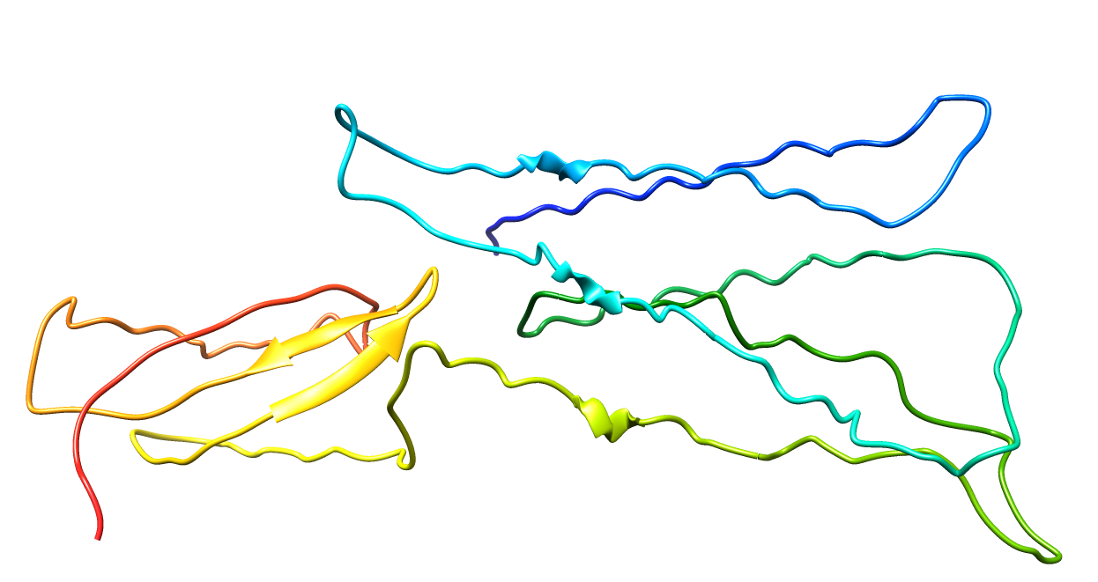
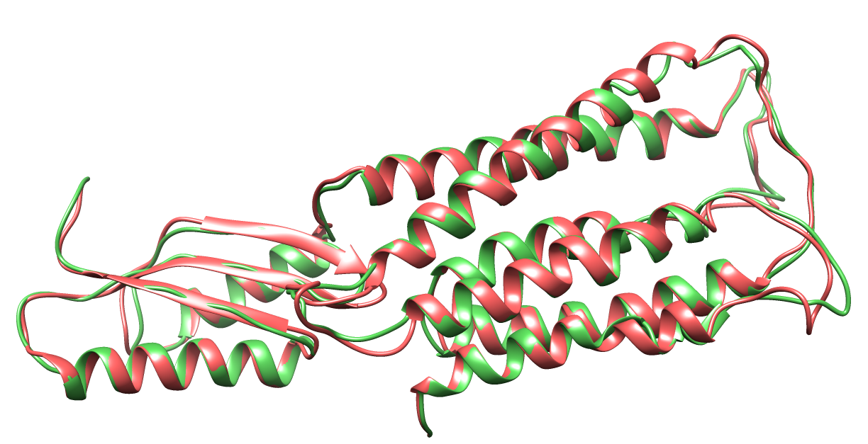
Structure folding using gradient descent
Without secondary structure restraints
3H90-A
Add secondary structure restraints
3H90-A
Red: native Green: model
TM-score: 1.00 RMSD: 0.017

Slide 2
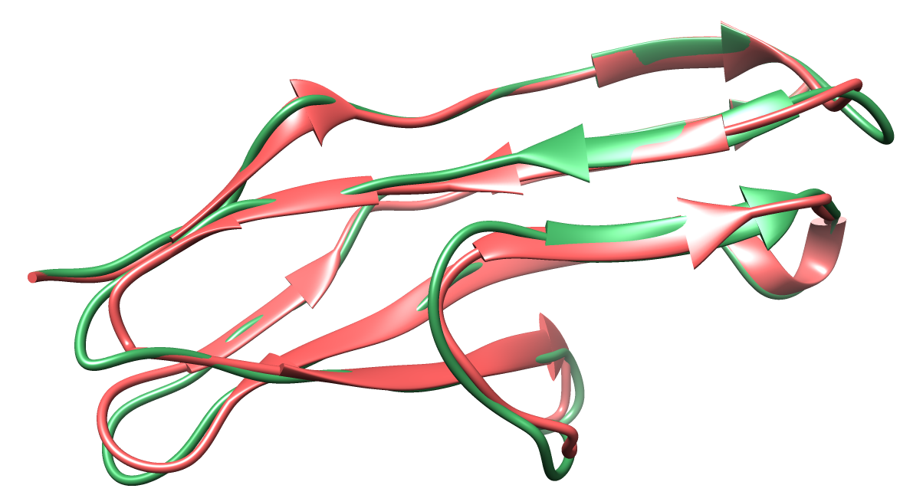
Structure folding using gradient descent
Add secondary structure restraints
3BFO-B
Red: native Green: model
TM-score: 1.00 RMSD: 0.015

